Slide 1





ONEEARTH INTERNATIONAL HACKATHON 2025
Problem Statement Title- AI-Powered Climate Impact Predictor
Hackathon Theme- Predictive Analytics for Climate Change Impact
Team ID- OEH-5-003
Team Name- ClimaCast

Slide 2
Concept : AI-Powered Climate Impact Predictor
OEH-5-003
The Idea: Turn complex climate data into simple, actionable forecasts.
What It Does:
Forecasts Future Trends
Analyzes Historical Data
Generates AI-Powered Recommendations
Innovation:
An AI-driven advisor that provides clear, actionable insights.

Slide 3

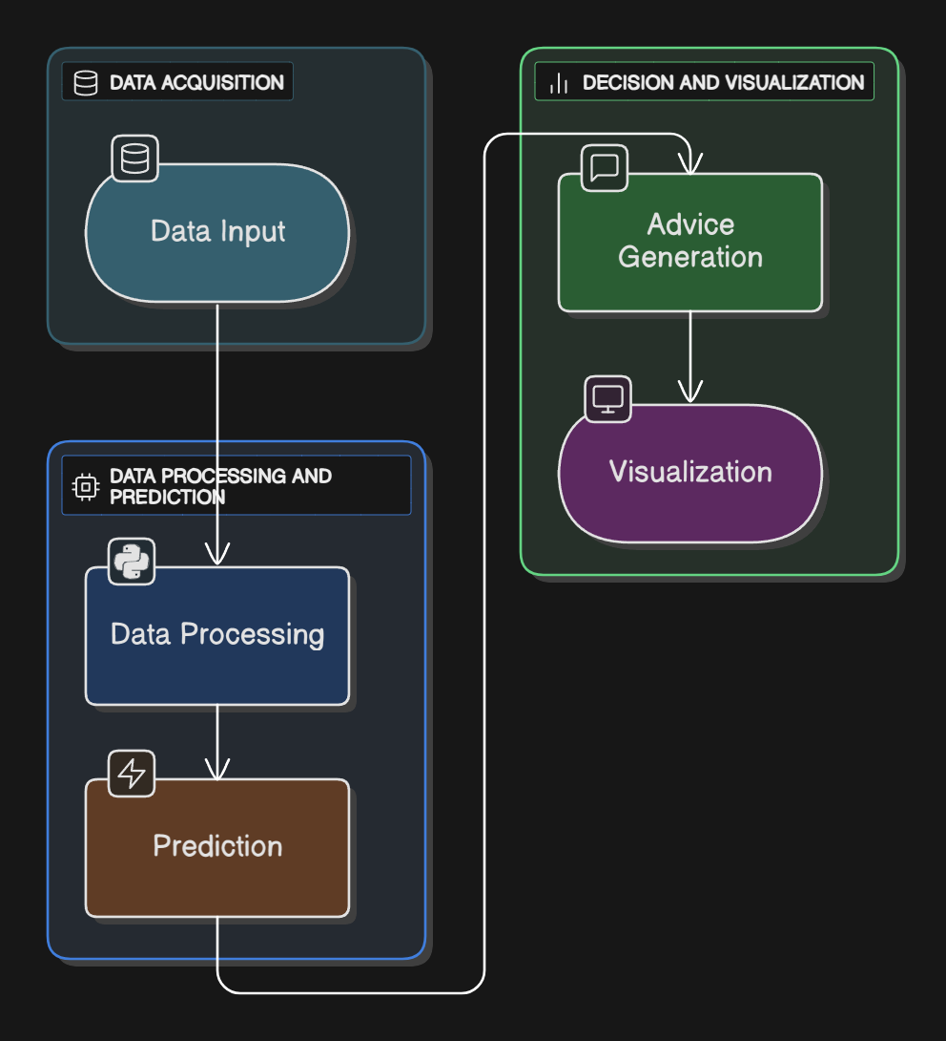
TECHNOLOGICAL STRATEGY
Technologies:
Python
FastAPI
Streamlit
Prophet
LSTM
Workflow:

Slide 4
PRACTICALITY AND VIABILITY
Viability:
Functional prototype already exists.
Built with low-cost, open-source tools.
Risks:
Data Gaps, Model Drift, Scalability.
Solutions:
Data Validation, MLOps Monitoring, Cloud Deployment.

Slide 5
IMPACT AND ADVANTAGES
Impact :
Policymakers
Agriculture
Researchers
Advantages:
Social: Improves community preparedness.
Economic: Reduces climate-related financial loss.
Environmental: Drives sustainable action.

Slide 6
RESEARCH AND REFERENCES
Data:
NOAA Api key dataset
OpenWeatherMap Api key dataset.
Technology & Concepts:
Facebook Prophet
LSTM Networks
IPCC Reports

